Slide 1
Fantasy Educator
Felix Morenc and Aleksandar Hadzhiev

Slide 2
Presentation Timeline
Persona
Scenario
Goals of the MVP
Initial Wireframes
Developed Wireframes
Demo
Further plans outside scope of MVP

Slide 3
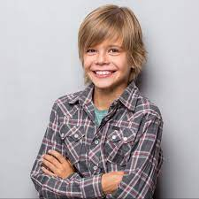
Persona - Thomas the Middle School Student
Age: 14
Comfortable with technology
Always online in some manner
Good knowledge of tech terms
Struggles with traditional learning
Can’t concentrate
Finds traditional education “boring”
Results in low grades at school
Gamer
Spends most of his free time gaming
Enjoys fantasy oriented games

Slide 4

Scenario
Thomas is currently really struggling at school, as he never pays attention in class and never does his homework
Traditional learning bores him, resulting in low grades
He needs a way to learn important concepts and subjects, in a way that is both stimulating as well as appealing to his general likes, specifically gaming, here comes Fantasy Educator!

Slide 5
Scenario
Thomas goes to our website
Starts a game
Defeats the boss

Slide 6
Goals within the scope of the MVP
Various difficulty questions
Questions about the subjects being learnt by students
Health mechanic for both boss and player
Extra mechanics to add complexity (Double Damage)
Sound/Animations to stimulate the player
Ability to retry as many times as required
Webshare functionality

Slide 7
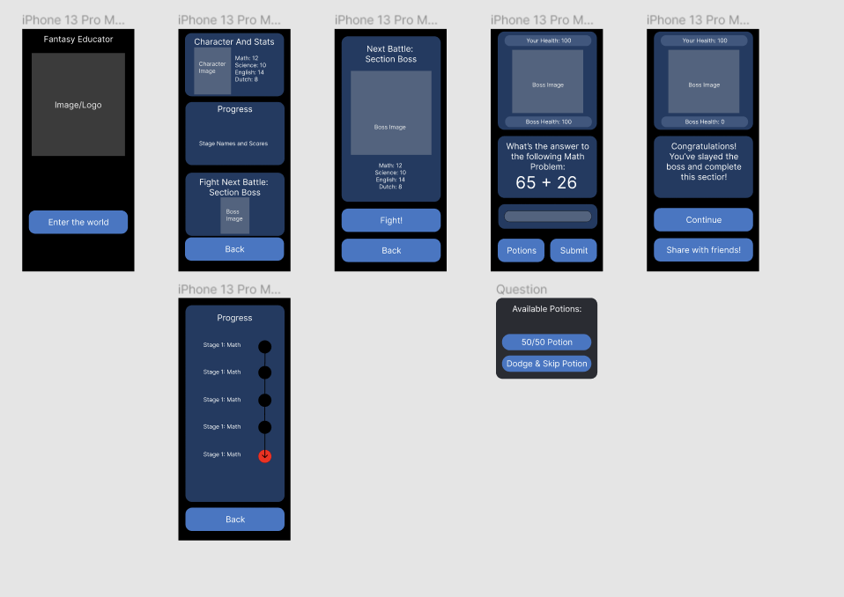
Low-Fidelity Wireframes

Slide 8
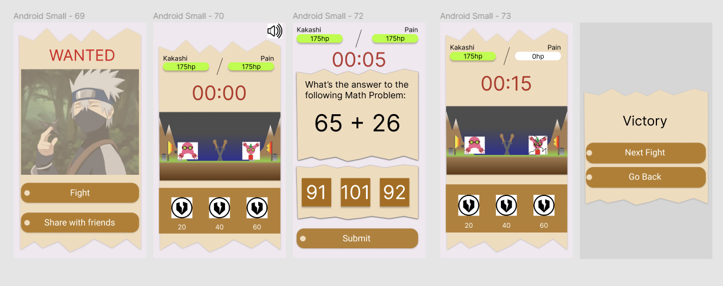
Final Wireframes

Slide 9
Demo

Slide 10
Potential Features Planned Outside Scope
Potion power-ups for the user to use
More stages with a branching path
Level system
Different characters and skins
Items to play for
Multiplayer 1v1 battle
Notification features
Fully offline mode

Slide 11
Thanks for Listening

